Slide 1





Riwu Julian Ruomu Shaun

Slide 2
7
How many objects can your mind hold in working memory?

Slide 3

Labour Day on
1 May
Meet Juliet tomorrow at 3pm
Submit sales report to boss by Fri
John’s wedding 15 May 8-10am
Gym session every 2 days 7-9pm
Safety briefing every Monday
Read War and Peace

Slide 4
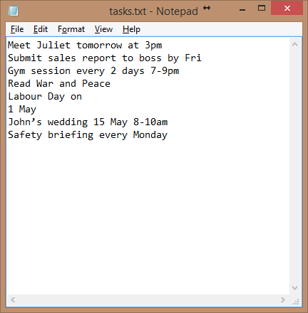

Slide 5
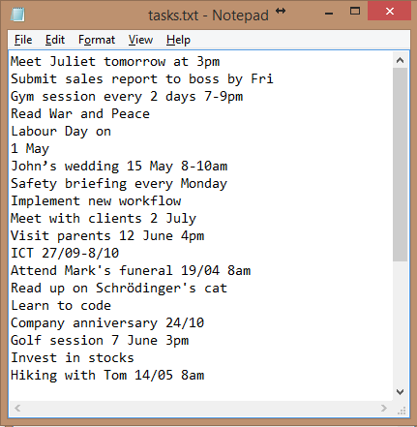

Slide 6
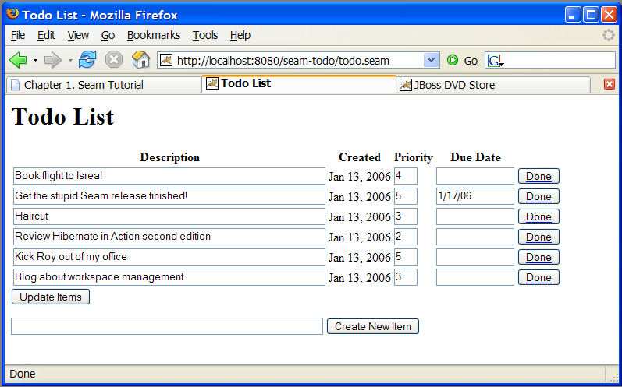
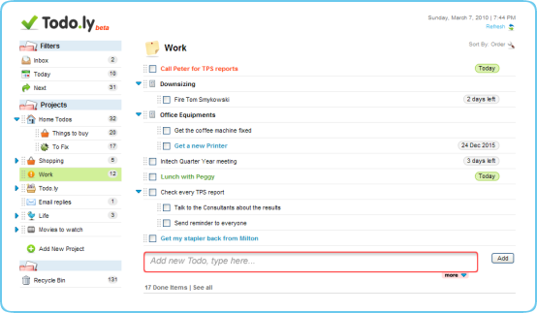
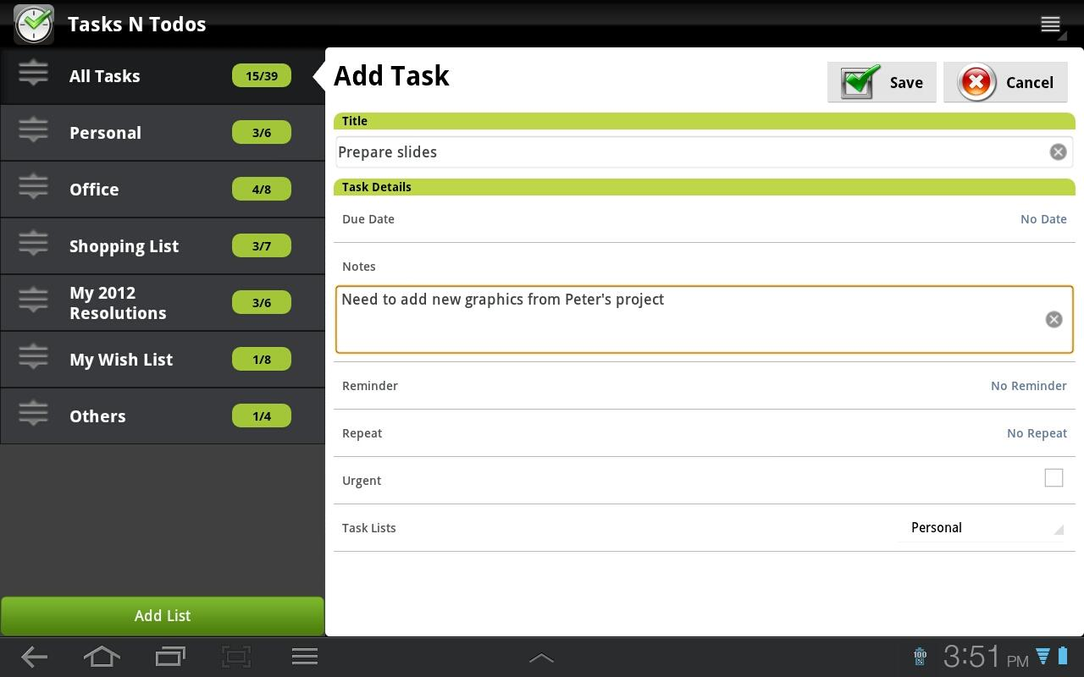
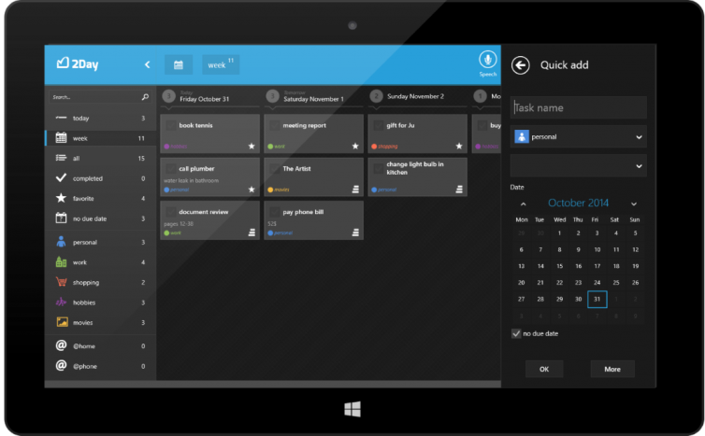
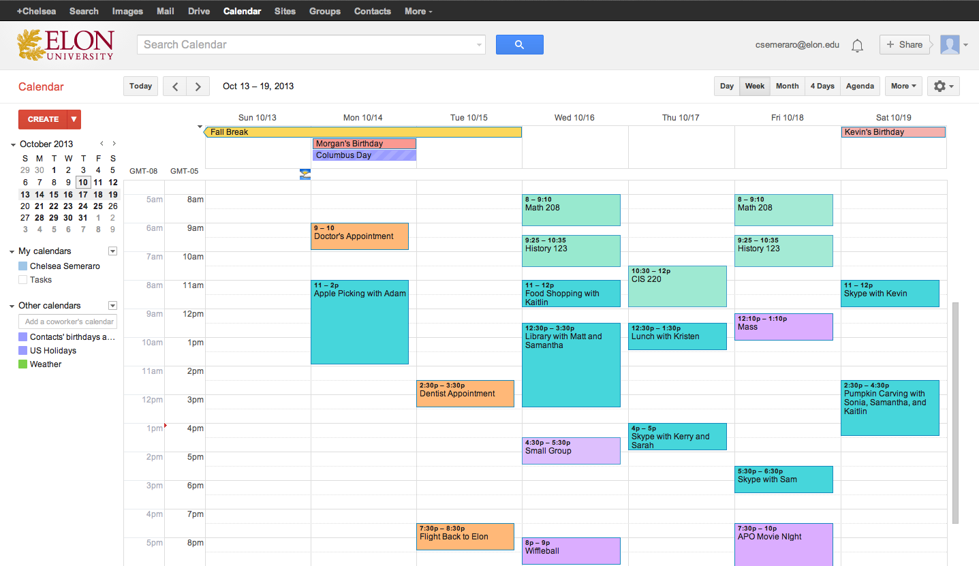

Slide 8
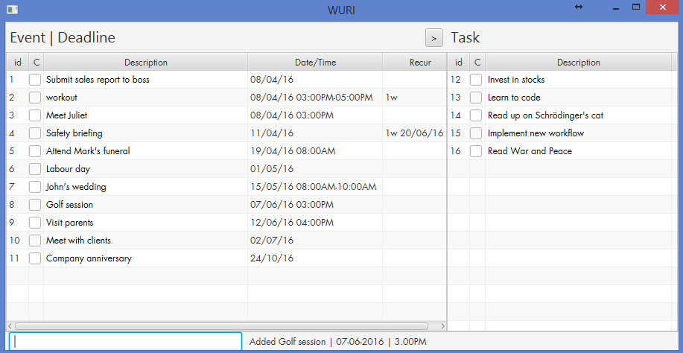
Sorted
No date
Input box
Notes:
Label components

Slide 9
Free and Open source
Safe and Virus-free
Continuously developed; never obsolete
Customisable by any programmer

Slide 10
Run on anything with Java
Download for free at www.java.com
Windows, Linux, Mac

Slide 11
Reliable
Task list saved to file after every operation.
Stable and never crashes

Slide 12
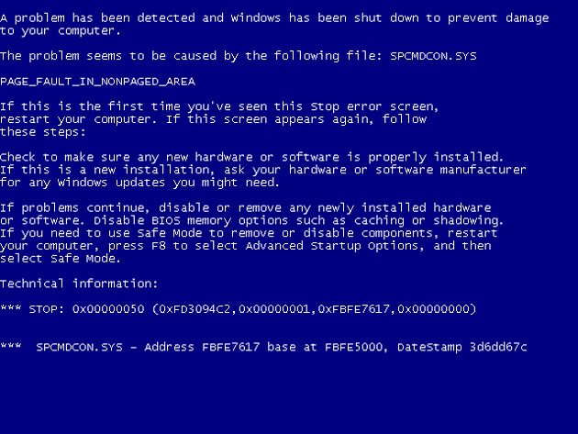

Slide 13
Performance
Saving done only after list updated on display
No perceivable delay

Slide 14
Ease of use
Only need keyboard
Minimal keywords
Single letter commands

Slide 15
Mark as complete
E.g.
“c 15” – mark/demark the task with ID 15
Notes:
Thank you Julian, I will continue with Julian’s demonstration and show you how powerful WURI is. As a todo list software, WU.RI will definitely allow you to mark a event as complete. For example, Zootopia is on show now. Let’s assume you have just watched this movie, then you could type c 8 to mark the “watch a movie” task as completed. After watching the movie, you want to go kinokuniya to find some book to read, then you may want to use “t 10” to mark the “Read books” as complete. Then basically this is everything you want to do today, so you also use “c 2” to complete the “Do everything”. Now, on WURI you can see you have completed 3 tasks today~~~ Congrats~~~ But what if you suddenly decided that you need to listen to a concert today also. Then you can use the same command “c 2” to remark the “do everything” as incomplete again. In summary, if you want to mark certain task as complete/incomplete, just type in c + the id of the task.

Slide 16
Delete
E.g.
“d 2” – Delete the task with id 2
“d <11/4/16” – Delete all the tasks before 11/4
“d + id + r” for deleting recurring tasks
Notes:
After all, the “do everything” is a bit vague. You, as a perfectionist, do not want to see such ambiguous task. You may find the Deletion function useful. You can do deletion in many ways as you wish. You may want to use “d 2”, which means “delete task with id 2” to delete the “Do Everything” task. With WURI, you are efficient in your work, say you have finished all the tasks before the 10th of April, you can use “d <11/4” to delete all the tasks before 10th .

Slide 17
Undo
“u” – stands for “undo”
Notes:
WURI also allows you to revert you operations. Just now you have removed all the tasks before the 10th , but suddenly you become unsure about whether you have really completed all the tasks before that date. You want to make sure. So you can use the undo function provided by WURI, you type in a u, then just enter it. See, all the tasks you have just deleted come back. Looking at those tasks, you realize that you have indeed finished them, very good, we can delete them again.

Slide 18
find
E.g.
“f Alice” to find all the tasks related to Alice
“f” to display all tasks
Notes:
With so many tasks to do every day, you may need to search among all your tasks to find the one you need to do now. To demonstrate the find function, please allow me to input some data first. … Ok, now we have a lot of meetings here. We want to know when am I going to meet Alice, since I need to prepare some gift to her before I can go. You need not to eye power through all the tasks to locate the task with Alice, you can just type in “f Alice” to find all event related to Alice and then you can plan your work accordingly.

Slide 19
No need to remember commands!
Always feel free to use “h” or F1 to call up the help window
Notes:
So many commands? No worry, you can always use h or F1 to call up the help window to find the command you need!

Slide 20
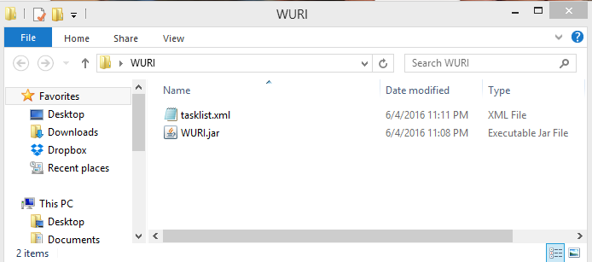
Saving
Default save path
Change file path
E.g. “s tasks”
Notes:
Thanks Ruomu, Hi everyone, I will now cover Saving tasks, storage and future plans.
As Riwu mentioned earlier, saving is done every step along the way.
By default, the task list is saved in the same folder as WURI.
However, you can change the file path by simply entering s, followed by the path.

Slide 21
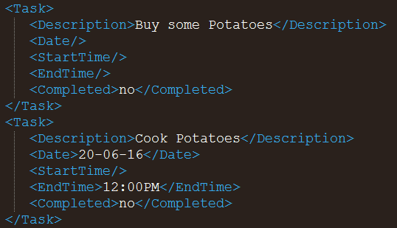
Storage
Extensible Markup Language (XML)
Simple structure
Easy to edit
Notes:
So how exactly is our task list saved?
We use the XML format, short form for extensible markup language.
For the less tech-savvy, all you need to know is that it is a very simple structure, as can be seen.
And it is very easy to edit.
There are tags for each attribute and all you need to do is just edit it there.
This also means that you can print it out and it will still be readable.

Slide 22




Storage
Notes:
Next,
I am pretty sure most of us here have multiple devices, be it a home desktop PC, or a mobile laptop or maybe a work pc.
Does it mean that we must have a separate task list for each device? Of course not!
As mentioned earlier by Riwu, we can actually set our savepath to a cloud storage, for example dropbox or google drive.
This allows your task list to be synchronized across all your devices.

Slide 23

What’s next?
Colour scheme
Change Fonts
Mobile App
Notifications
Modular
Encryption
Web App
Scalable
Autocomplete
Notes:
Now that WURI is officially launched, what’s next?
When we originally started work on WURI, we had 2 points in mind, modular and scalable.
This allows us to easily add new features to WURI.
I will now cover a few of these upcoming features.

Slide 24


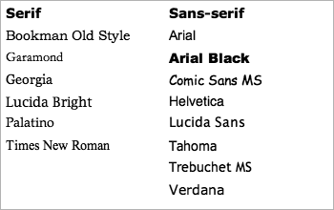
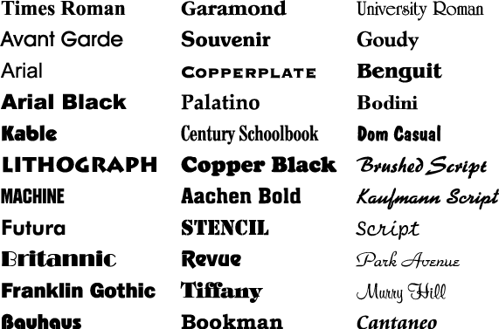

What’s next?
RAINBOW!!
WURI looks better in PINK!
WHERES MY COMIC SANS?
1. Colour scheme
2. Font
I want colours
PINK! BLUE! WHITE! ORANGE! PURPLE! GREEN!!
Notes:
Firstly, you spoke and we listened.
We have gathered overwhelming feedback from our beta testers requesting for the option to change your colour scheme and font.
This will be implemented in the next release.

Slide 25

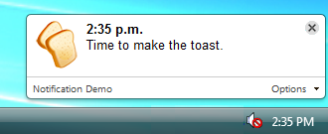
What’s next?
3. Notifications
Notes:
Next up! We have notifications!
You will be able to customize and set your own notification ringtone or set from a list of default sounds.
But if you do not like to have audio notifications, fret not!
We will also support just pop-up notifications, like this example here!

Slide 26




What’s next?
4. Encryption
Notes:
Next up we have Encryption,
If you have sensitive data in your tasklist, or perhaps want to hide certain tasks from other people, you can choose to encrypt certain tasks using a password.
You will only be able to view these tasks after you key in your password.

Slide 27
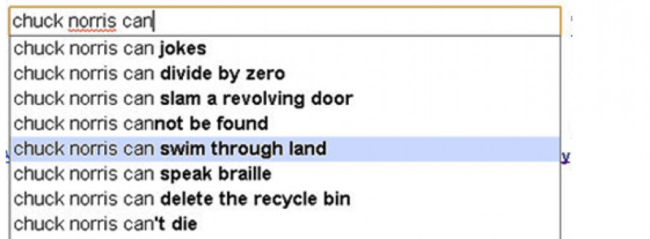
What’s next?
5. Autocomplete
Personalized
Notes:
Next up, we have the autocomplete function, which allows us to in a way predict what you will type based on your previous tasks.
This is personalized, meaning, if for example, you are a medical student who uses many medical terms and jargons, they will all be added into your personal dictionary.

Slide 28
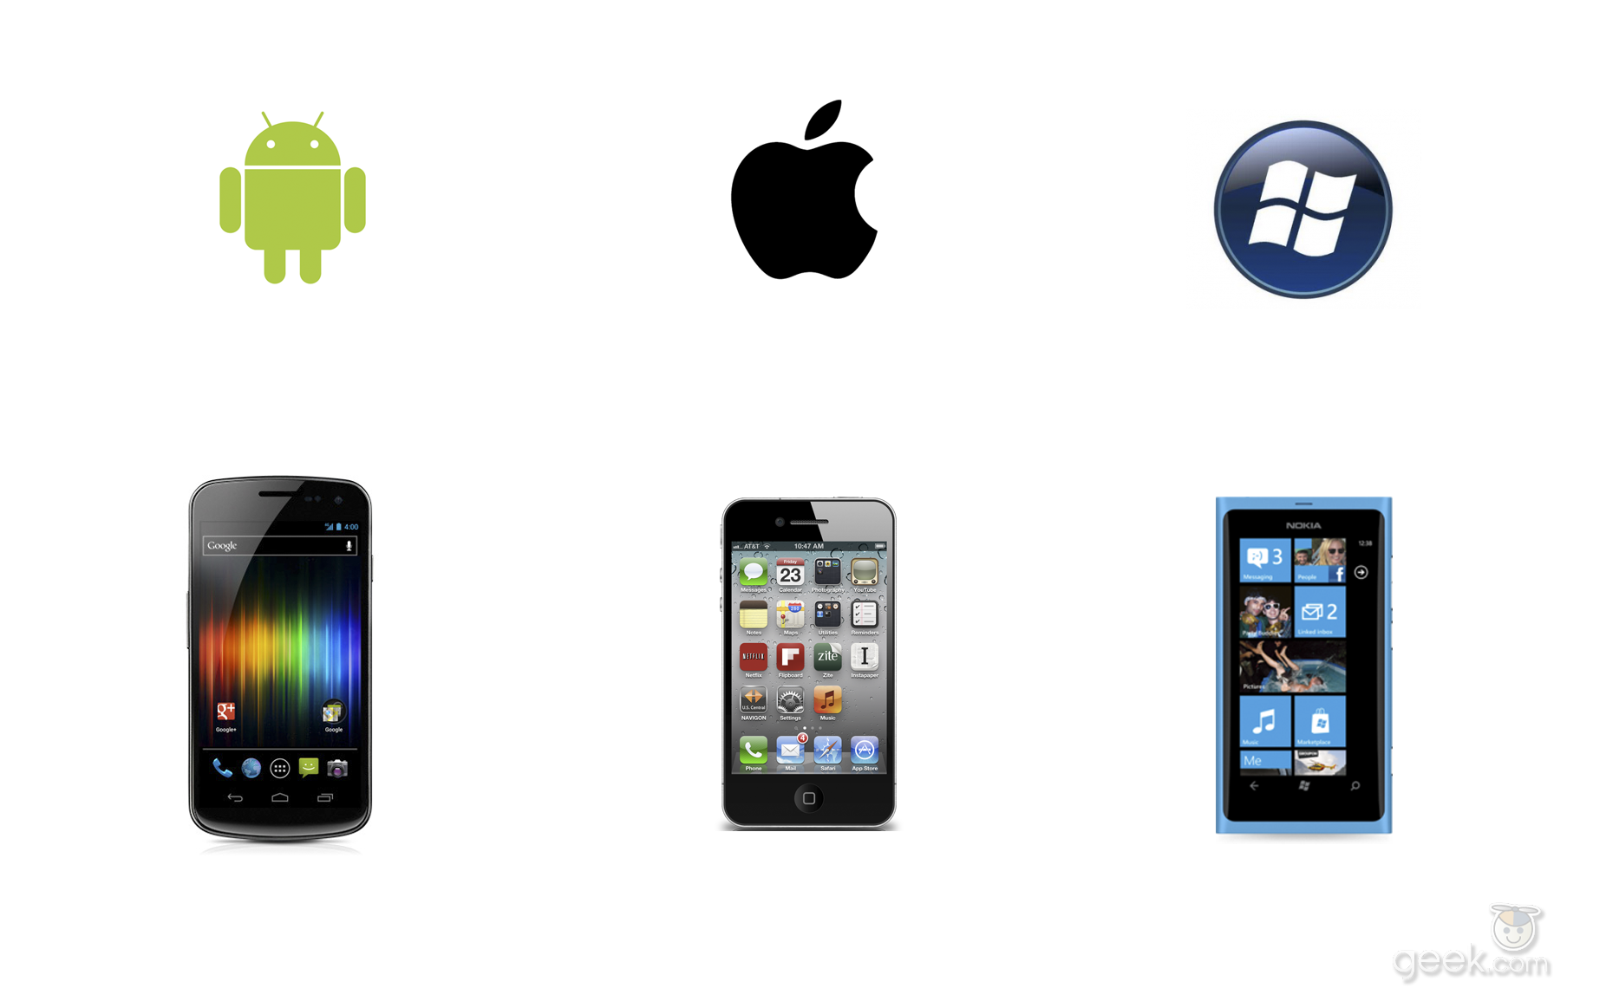

What’s next?
6. Mobile support
7. Web Application
Notes:
Next, I’m pretty sure that most of us have mobile phones, hence the next step for us is to go mobile.
We will support the 3 major mobile systems, android, apple and windows phone.
After which, we will also create a web application for WURI. This is similar to for example google docs, you will not even need to download WURI and run it on your computer.
All you need to do is to go to www.Wuri.com on your browser and everything will be there.

Slide 29
Now
WURI is officially launched.
Download from www.github.com
Next release: 30th April 2016
Feedback@WURI.com
Notes:
Lastly, we would like to announce that as of today, WURI is officially launched.
You may download the latest version of WURI from github.com.
The next release with all of the beforementioned functions is projected to be released on the 30th of April 2016!
Lastly, please direct all feedback to this email address.
With this, I end our presentation, thank you for your time.
We shall now head on to the Q & A session.

Slide 30
Q & A

